Slide 1
Minor Project on Covid-19 (State-Delhi)
By Tanu Kaistha H12125
Mentor: Jasmine Kaur

Slide 2
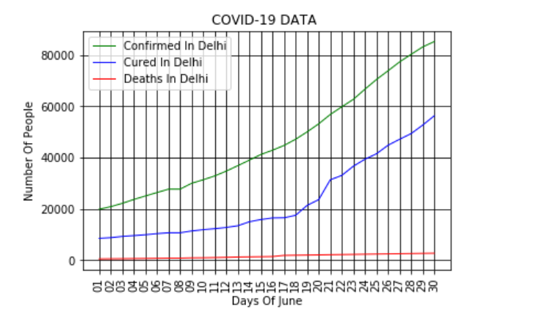
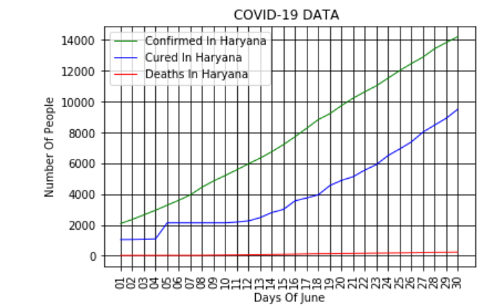
Minor Project

